Slide 1
Data Transformation Strategies
Why preprocess the data?
Data cleaning
Data integration and transformation
Data reduction
Discretization and concept hierarchy generation
Summary

Slide 2
Data Transformation
Smoothing: remove noise from data – Binning, regression, clustering
Aggregation: summarization or aggregation operations, data cube construction
Attribute/feature construction
New attributes constructed from the given ones to help in the data mining process
Generalization: concept hierarchy climbing (Generalized to higher level concepts)
Discretization: numeric data to interval labels or conceptual labels
Normalization: scaled to fall within a small, specified range
  min-max normalization
  z-score (zero mean) normalization
  normalization by decimal scaling

Slide 3
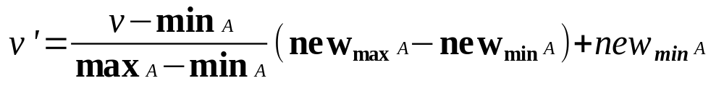
Data Transformation: Normalization
min-max normalization
Example – income, min $55,000, max $150000 – map to 0.0 – 1.0
$73,600 is transformed to :
  73600-55000 (1.0 – 0) + 0 = 0.196
  150000-55000

Slide 4
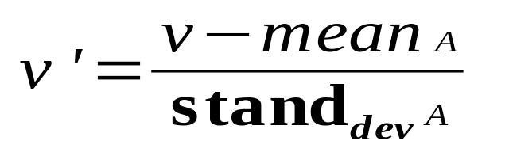
Data Transformation: Normalization
z-score normalization
Example – income, mean $33000, sd $11000
$73600 is transformed to :
  73600-33000 = 3.69
  11000

Slide 5
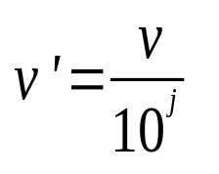

Data Transformation: Normalization
normalization by decimal scaling
Example recorded values - -722 to 821
Divide each value by 1000
  -28 normalizes to -.028
  444 normalizes to 0.444
Where j is the smallest integer such that Max(| |)<1

Slide 6
Discretization
Three types of attributes:
  Nominal — values from an unordered set
  Ordinal — values from an ordered set
  Continuous — real numbers
Discretization:
  divide the range of a continuous attribute into intervals
  Some classification algorithms only accept categorical attributes.
  Reduce data size by discretization
  Prepare for further analysis

Slide 7
Discretization and Concept hierarchy
Discretization
  reduce the number of values for a given continuous attribute by dividing the range of the attribute into intervals. Interval labels can then be used to replace actual data values.
Concept hierarchies
  reduce the data by collecting and replacing low level concepts (such as numeric values for the attribute age) by higher level concepts (such as young, middle-aged, or senior).

Slide 8
Discretization and concept hierarchy generation for numeric data
Binning (see sections before)
Histogram analysis (see sections before)
Clustering analysis (see sections before)
Entropy-based discretization
Segmentation by natural partitioning

Slide 9
Concept hierarchy generation for categorical data
Specification of a partial ordering of attributes explicitly at the schema level by users or experts
  Example : rel db may contain: street, city, province_or_state, country
  Expert defines ordering of hierarchy such as street < city < province_or_state < country
Specification of a portion of a hierarchy by explicit data grouping
  Example : province_or_state, country : {Alberta, Saskatchewan, Manitoba} – prairies_Canada & {British Columbia, prairies_Canada} – Western Canada

Slide 10
Concept hierarchy generation for categorical data
Specification of a set of attributes, but not of their partial ordering
  Auto generate the attribute ordering based upon observation that attribute defining a high level concept has a smaller # of distinct values than an attribute defining a lower level concept
  Example : country (15), state_or_province (365), city (3567), street (674,339)
Specification of only a partial set of attributes
  Try and parse database schema to determine complete hierarchy

Slide 11
Specification of a set of attributes
Concept hierarchy can be automatically generated based on the number of distinct values per attribute in the given attribute set. The attribute with the most distinct values is placed at the lowest level of the hierarchy.
country
15 distinct values
province_or_ state
65 distinct values
city
3567 distinct values
street
674,339 distinct values

Slide 12
Summary
Data preparation is a big issue for both warehousing and mining
Data preparation includes
  Data cleaning and data integration
  Data reduction and feature selection
  Discretization
A lot a methods have been developed but still an active area of research

Slide 13

Homework Assignment
Design a data warehouse based on the hurricane data provided (four years of data)
  Two data sources with slightly different formats and data
Utilize a star or snowflake schema
Implement the data warehouse utilizing relational tables in postgres
Integrate the data from the two separate data sources and import into your data warehouse
  Keep the data warehouse as you will utilize it in your next homework assignment
Due March 18 at the start of class

Slide 14
Homework Assignment (cont)
Data Source 1
Table 1. Best track, Hurricane Alberto, 3 - 23 August 2000. Date/Time
(UTC) Position Pressure(mb) Wind Speed (kt) Stage Lat. (°N) Lon. (°W)
03/ 1800 10.8 18.0 1007 25 tropical depression
04 / 0000 11.5 20.1 1005 30 "
04 / 0600 12.0 22.3 1004 35 tropical storm
04 / 1200 12.3 23.8 1003 35 "
04 / 1800 12.7 25.2 1002 40 "
05 / 0000 13.2 26.7 1001 40 "
05 / 0600 13.7 28.2 1000 45 "
05 / 1200 14.1 29.8 999 45 "
05 / 1800 14.5 31.4 994 55 "

Slide 15
Homework Assignment (cont)
Data Source 2
Date: 04-23 AUG 2000
Hurricane ALBERTO
ADV LAT LON TIME WIND PR STAT
1 12.20 -22.70 08/04/09Z 30 1007 TROPICAL DEPRESSION
2 12.40 -25.00 08/04/15Z 35 1005 TROPICAL STORM
3 12.90 -25.90 08/04/21Z 50 999 TROPICAL STORM
4 13.40 -27.50 08/05/03Z 50 999 TROPICAL STORM
5 13.70 -28.70 08/05/09Z 55 994 TROPICAL STORM
6 14.40 -30.70 08/05/15Z 50 1000 TROPICAL STORM
7 14.70 -32.10 08/05/21Z 65 990 HURRICANE-1

